Slide 1
Backend
Ahmed Hesham

Slide 2
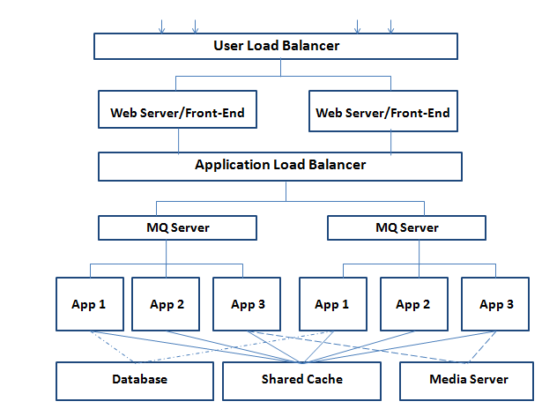
Message Based Architecture Layout

Slide 3

How Can We Serve Concurrently?

Slide 4
Threading Models for Server
Blocking
Non-Blocking
Multiplexing
Signal Driven
Asynchronous

Slide 5
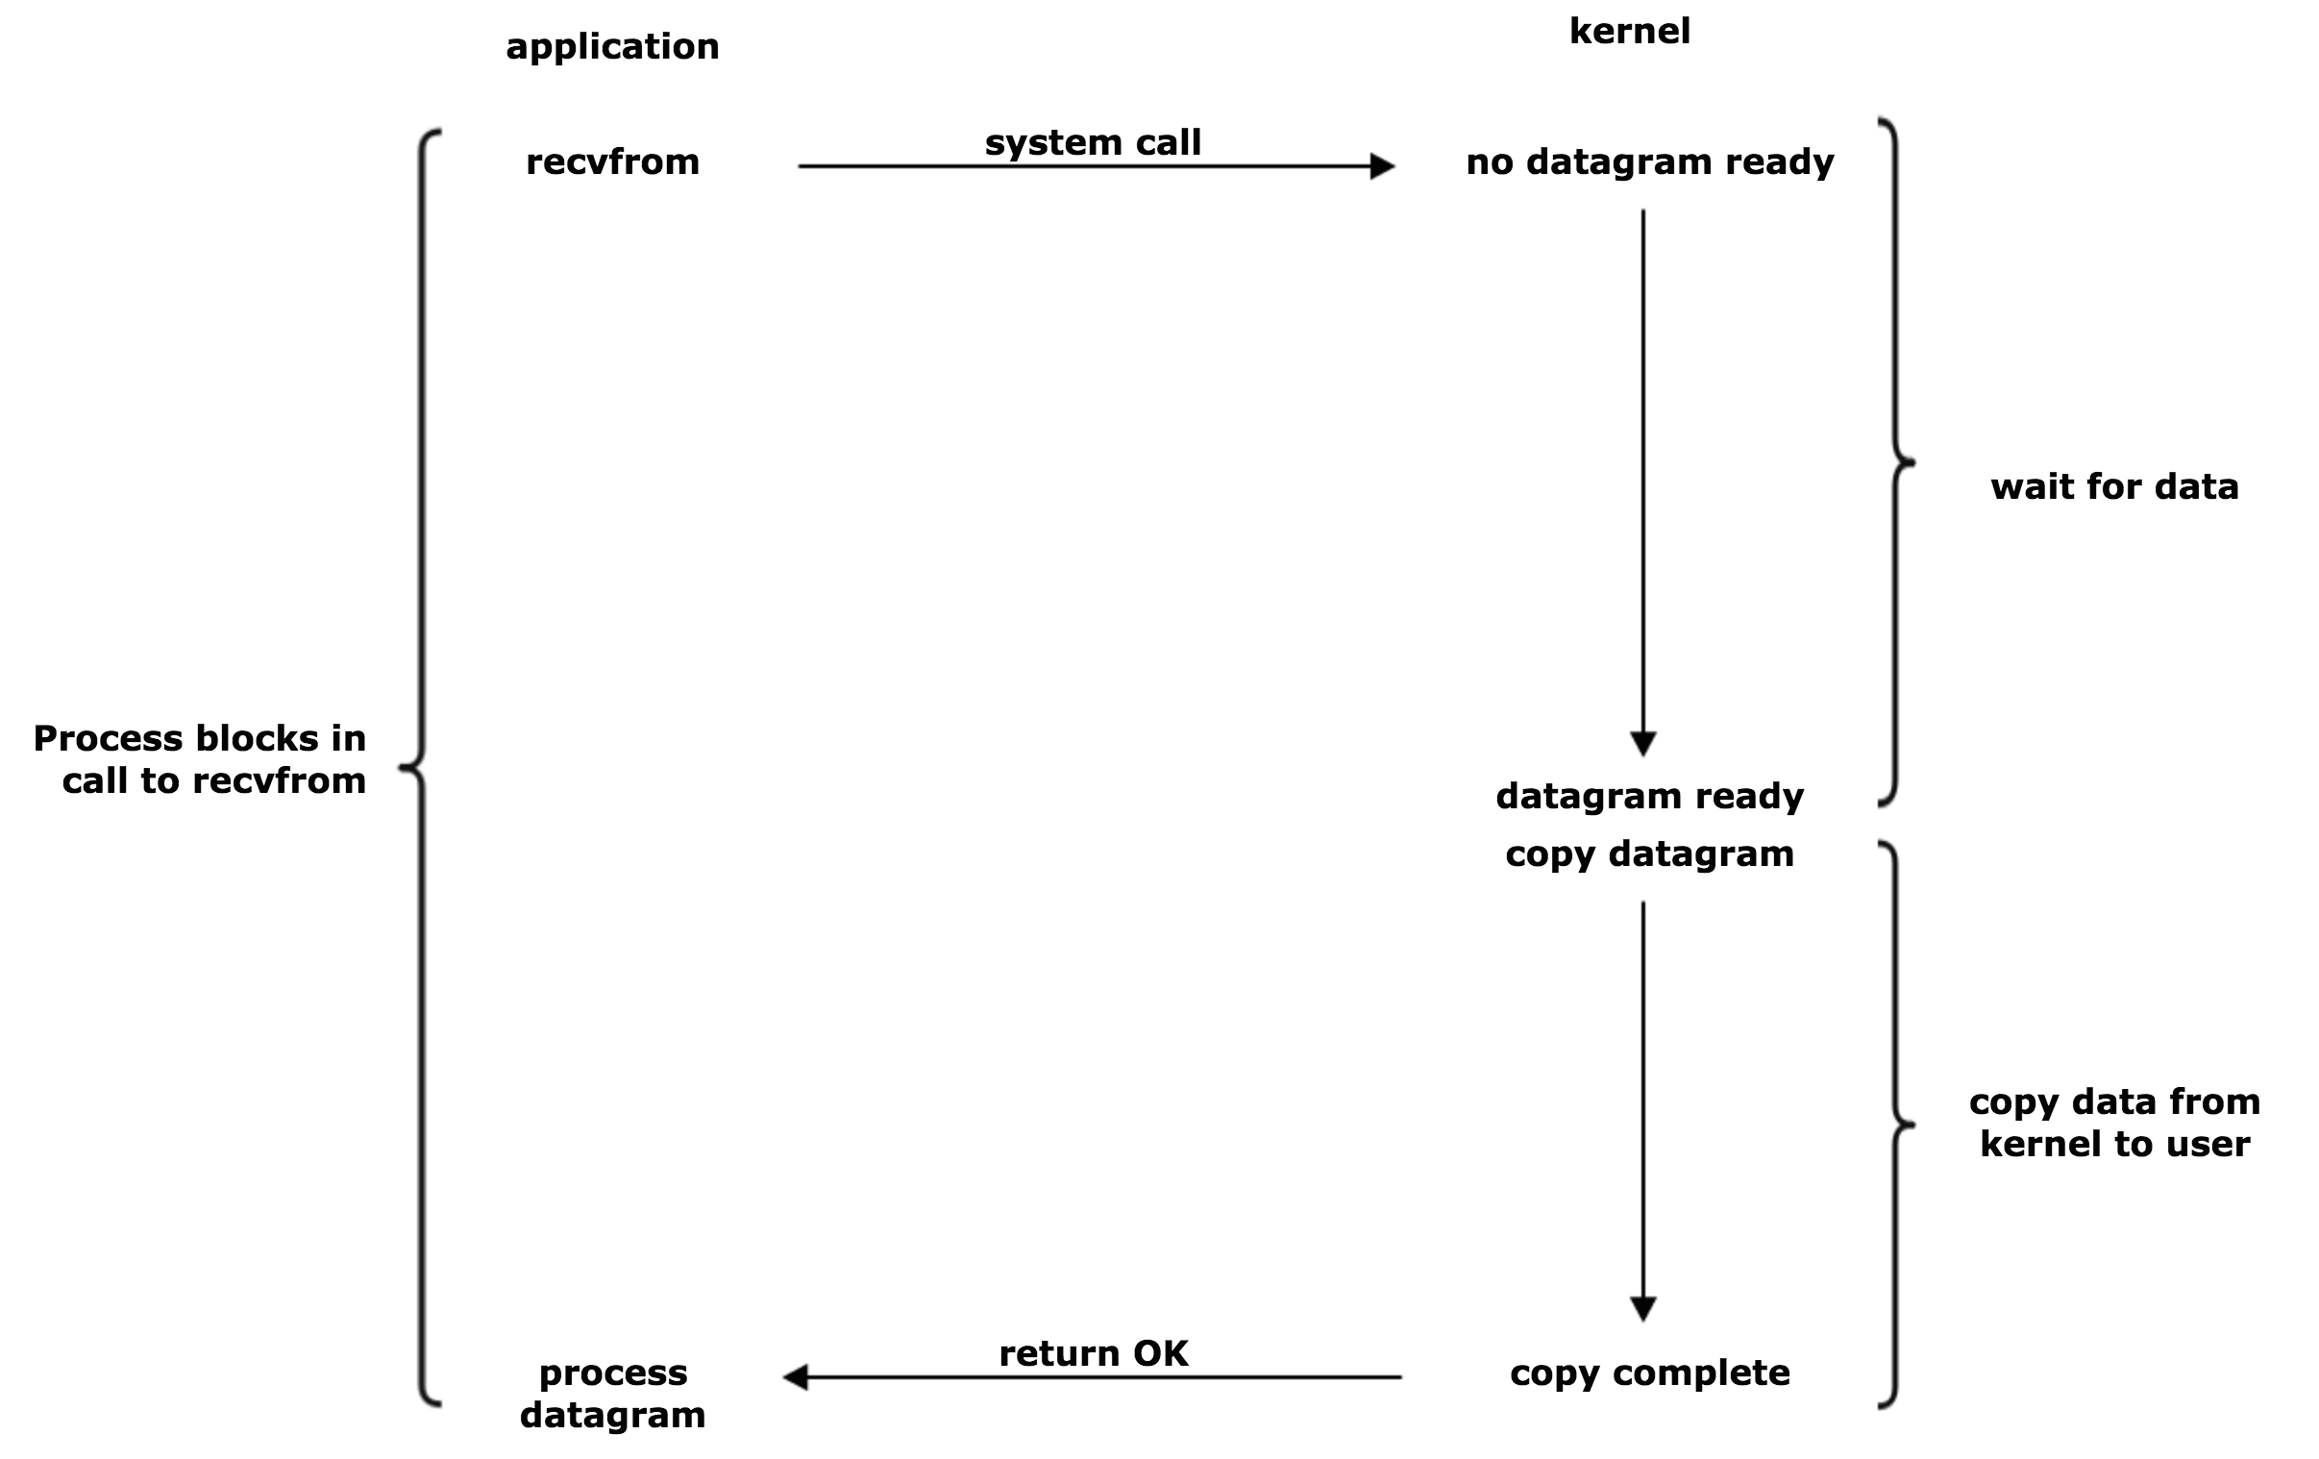
Blocking

Slide 6
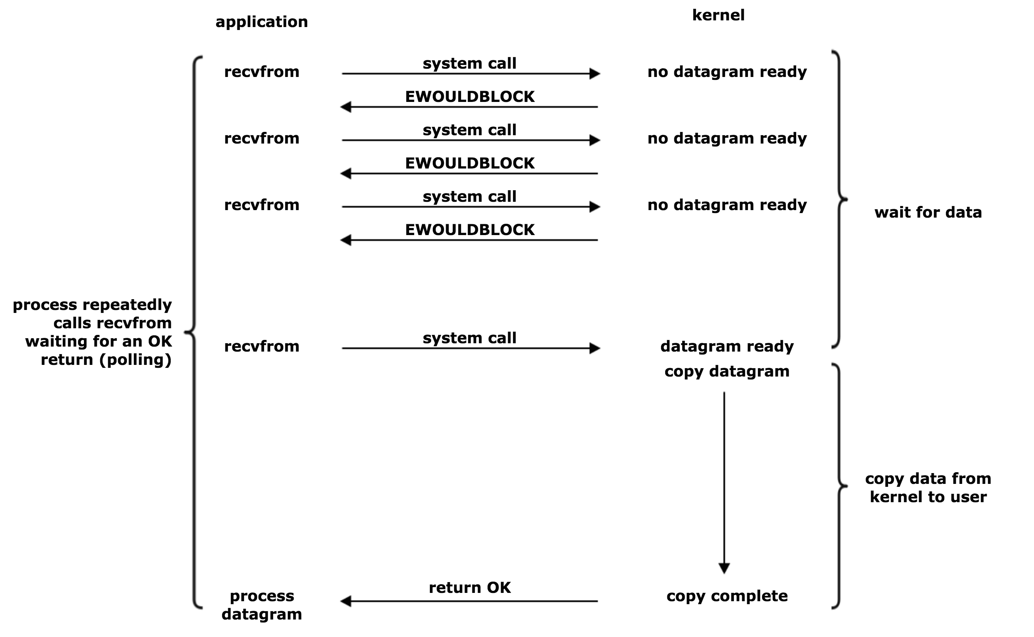
Non-Blocking
Notes:
Improves on blocking
Two files, A + B read at same time, CPU in infinite loop waiting

Slide 7
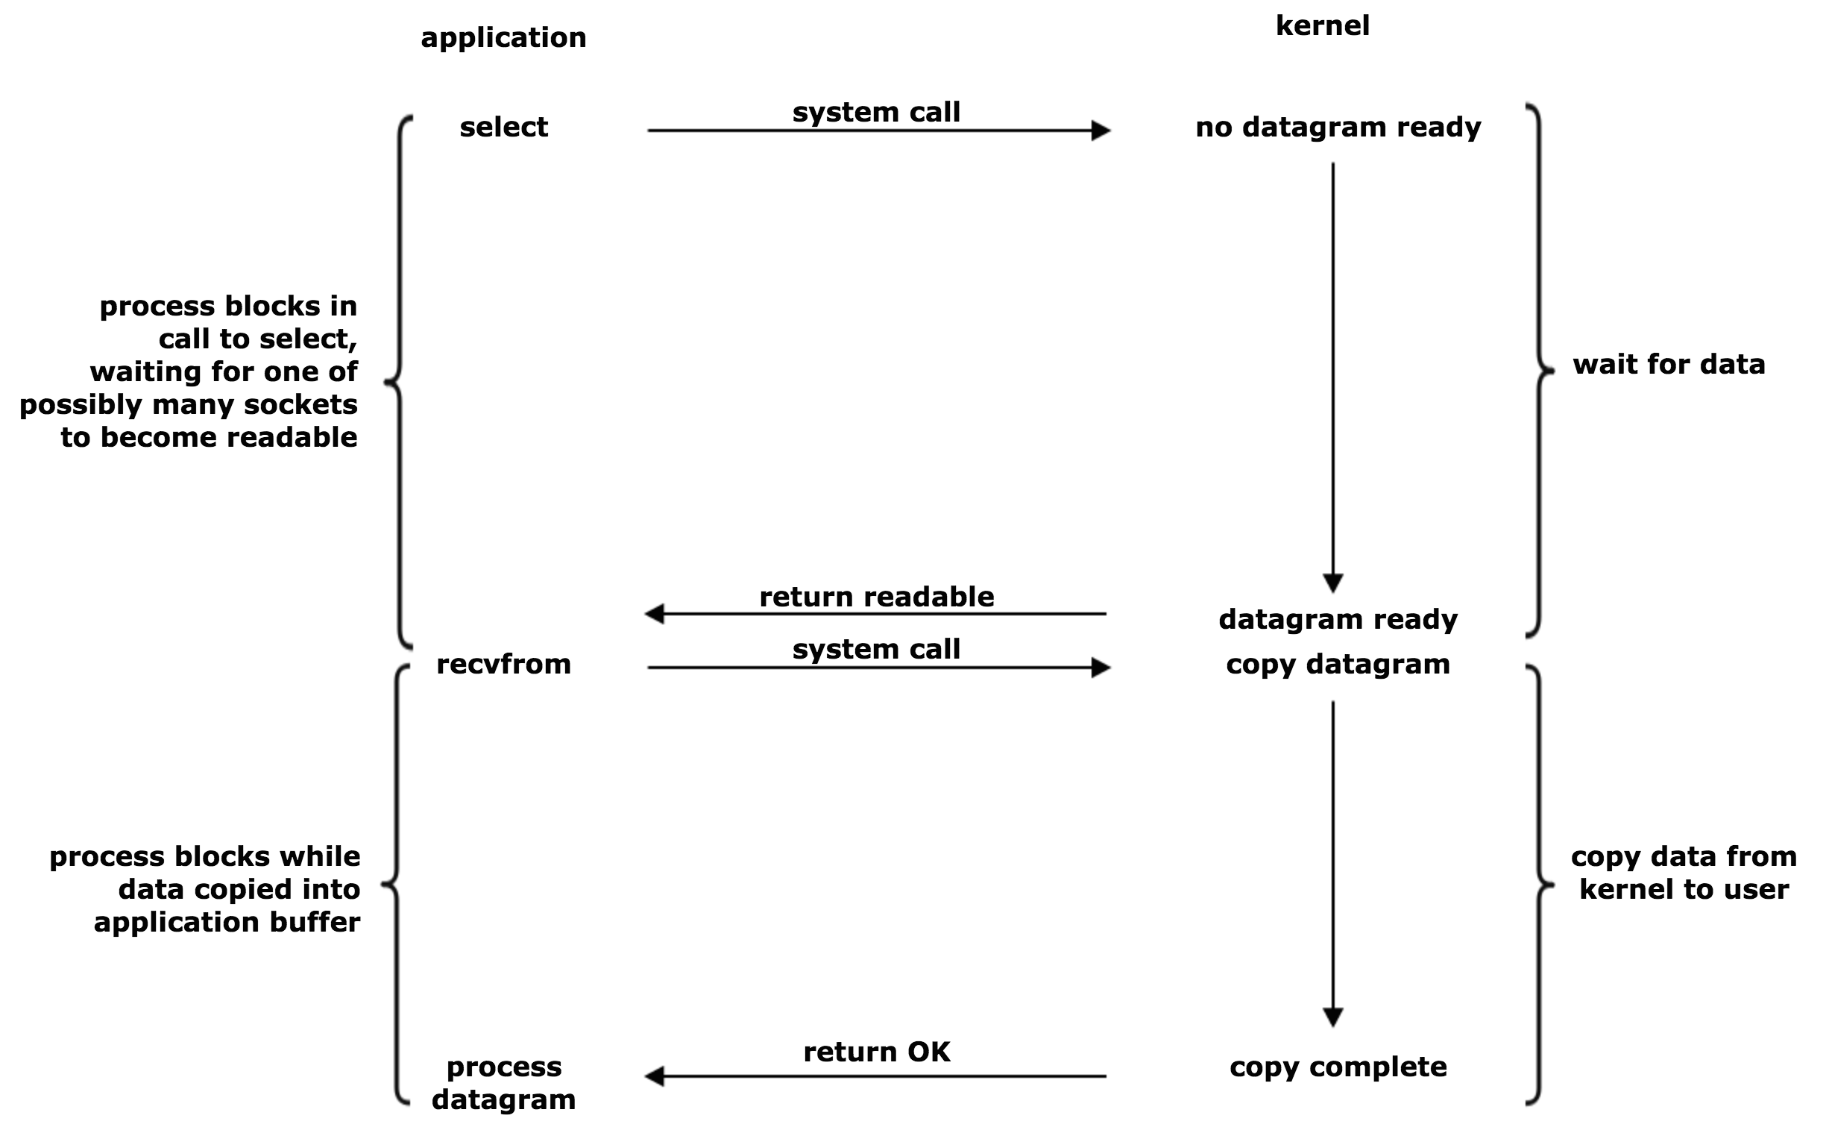
Multiplexing
Notes:
Improves on non-blocking

Slide 8
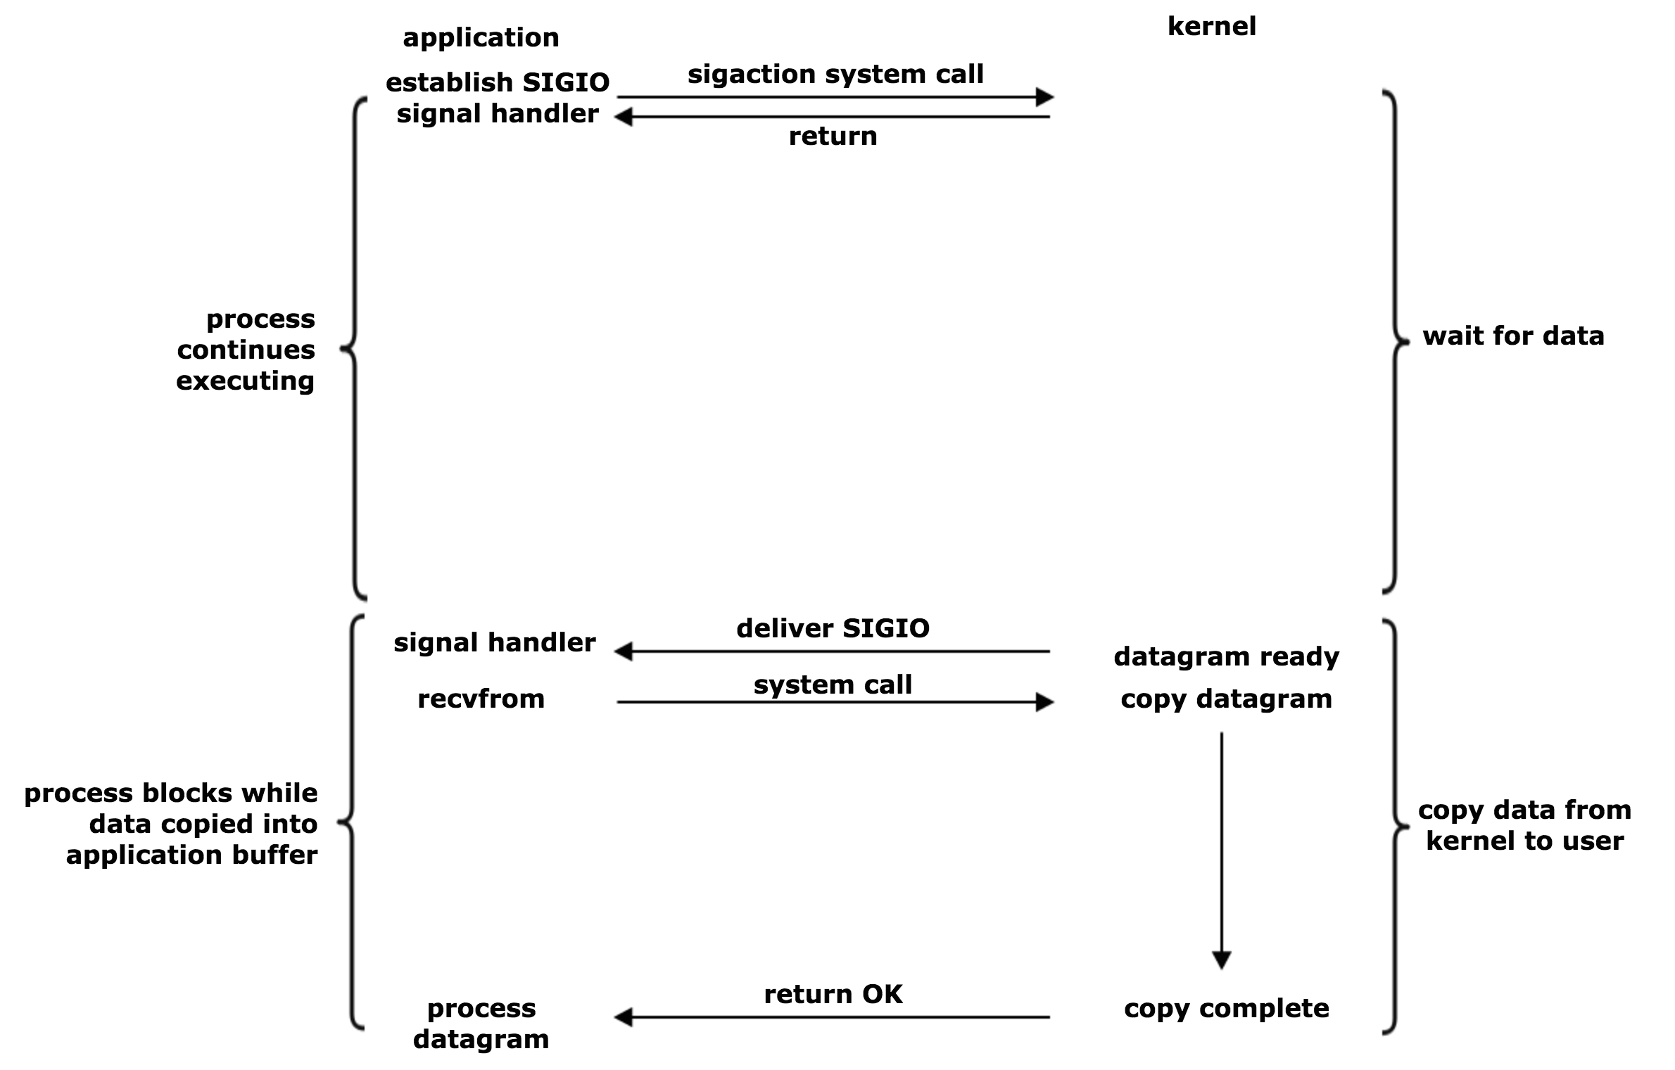
Signal Driven
Notes:
Improves on multiplexing

Slide 9
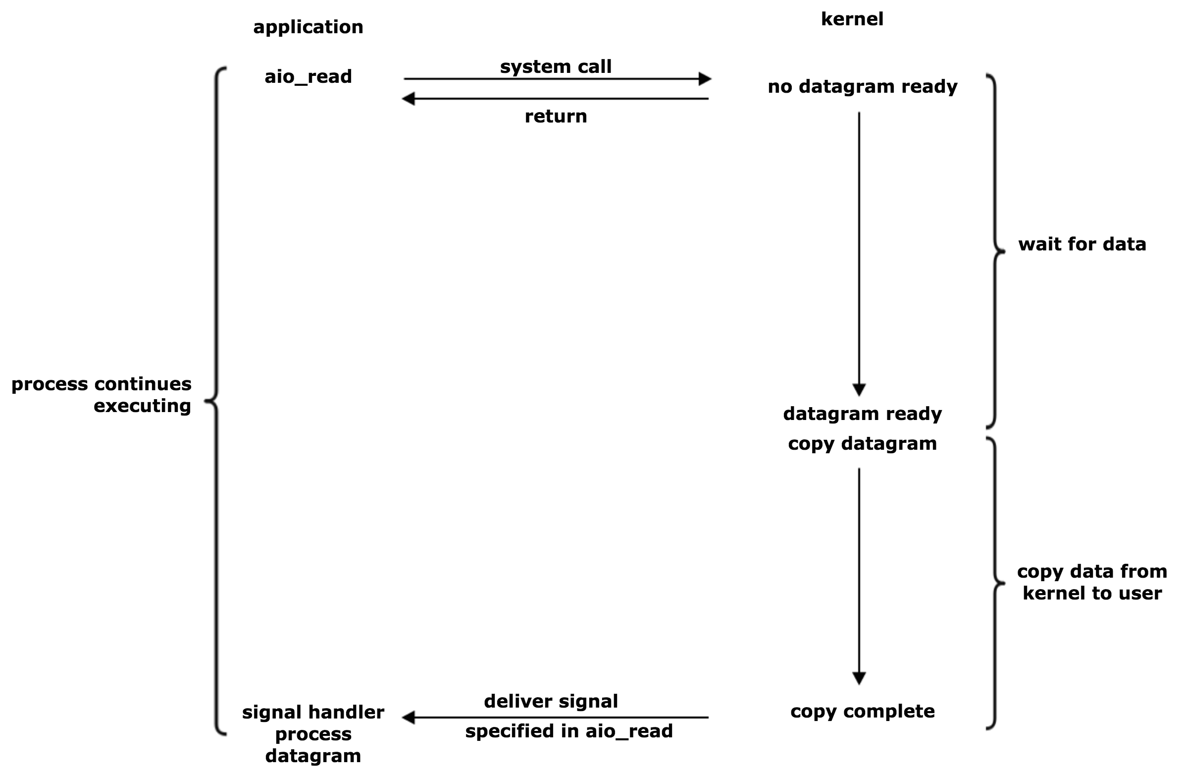
Asynchronous
Notes:
Best form in theory but hardest to implement

Slide 10
How to improve performance?

Slide 11

Issue – I
User requests same item multiple times or item is requested by multiple users

Slide 12
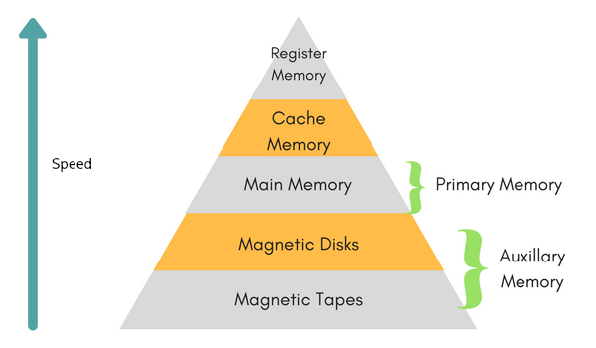
Solution – I
Store frequently accessed items in memory rather than disk

Slide 13
Caches
Store most frequently requested items in memory
Many forms of caches exist, from HTTP request caches to database cache systems
Caches can quickly a bottleneck if not utilized correctly

Slide 14
Cache Types
Standalone caches
Distributed caches
Notes:
typically used per independent application e.g. a database cache that stores most commonly viewed users
Distributed caches: used across applications to share information e.g. sharing session data

Slide 15
Common In Memory Cache Types
Key-value stores: large in memory hashmap
Usage example: caching number of likes per trending post than counting on disk
Document stores: JSON documents in memory
Usage example: caching post details in memory than retrieving from disk

Slide 16
Disk Caching
Disk caches also exist, faster devices are usually used to cache slower devices e.g. SSDs can be used to cache HDDs

Slide 17
Any other improvements?

Slide 18
Issue – II
Most programming languages have a garbage collector
Garbage Collectors add significant delay

Slide 19
Performance Enhancement – II
JVM allows developers to tune it to the performance of specific applications
Common tunings include
  Garbage collection algorithm
  Delay between garbage collections
  Size limit before collection
  Threads to use from OS

Slide 20
Garbage Collectors
Two main type of collectors exist:
  Stop The World
  Parallel
JVM offers multiple collectors

Slide 21
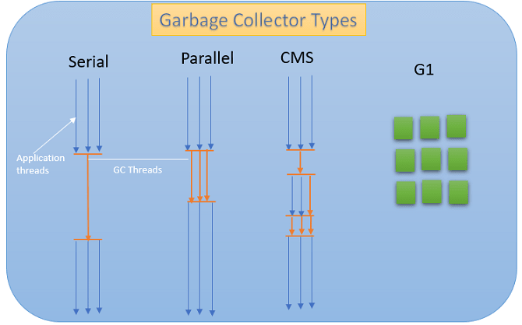
Garbage Collectors – continued

Slide 22
New Garbage Collectors
Shenandoah
  Improves on G1
  Large memory heaps
Z
  Low latency
  Scalable (NUMA)
  Large memory heaps
Epsilon
  Disables GC completely for code testing

Slide 23
How Should an MSA be Designed?

Slide 24
Metaprogramming
Reflection/Introspection is a form of metaprogramming allowing programmers to build dynamic classes
Micro-service oriented architectures typically use Command design pattern to utilize metaprogramming

Slide 25
Command Design Pattern

Slide 26
Dynamic Class Loading
The application should be designed to be require least amount of interaction from the developer
Why Java? It allows classes to be compiled and loaded while JVM is running rather than restarting it (hot loading)

Slide 27
Any Questions?

